Slide 1
Presentation brief for MCT’s
Title of presentation | Interpreting Models
Presentation length | 120 minutes (including labs)
Audience | Data Scientists planning to operate machine learning workloads on Azure
Purpose | Discuss the need for model interpretability Describe how to generate and interpret feature importance
(think) Student key takeaways | Model explainability is essential to expose bias and justify ML-driven decisions How can I include model interpretability in my ML operations process.
(feel) Student desired mindset | Encouraged to apply interpretability analysis to models
(do) Student outcomes | Interpret models trained by Automated Machine Learning Use Explainers to interpret custom-trained models
More information | For course feedback, please use the MCT Forums

Slide 2

Module 9: Interpreting Models

Slide 3
Agenda
Introduction to Model Interpretability
Using Model Explainers

Slide 4













Lesson 1
Introduction to Model Interpretability
Data
Cloud
AI

Slide 5
Model Interpretability in Azure Machine Learning
Statistical explanation of feature importance
Quantifies the influence of each feature on prediction
Important to identify bias or unintended correlation in the model
Based on the Open Source Interpret-Community package
Includes explainers based on common model interpretation algorithms like:
Shapely Additive Explanations (SHAP)
Local Interpretable Model-Agnostic Explanations (LIME)

Slide 6
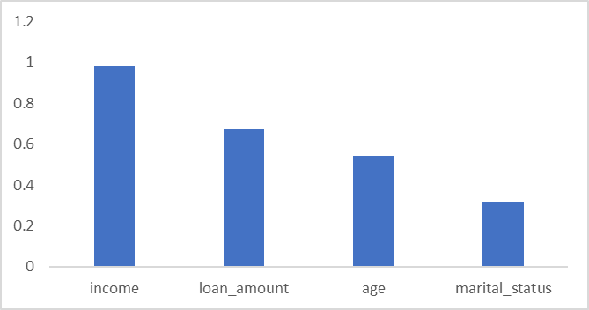
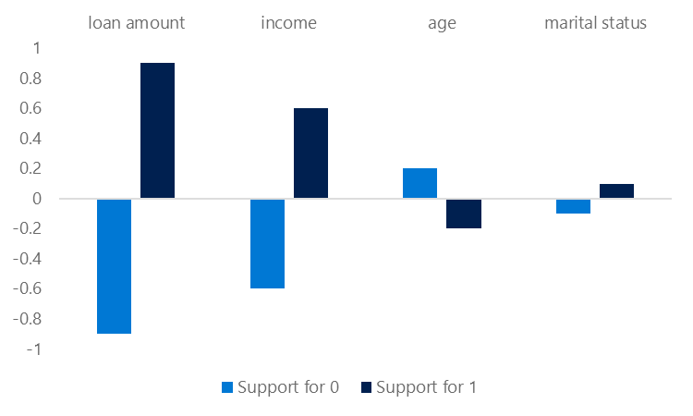
Global and Local Feature Importance
Global Feature Importance
Overall feature importance for all test data
Indicates ther relative influence of each feature on the predicted label
Local Feature Importance
Feature importance for an individual prediction
In classification, this shows the relative support for each possible class per feature

Slide 7
Automated Machine Learning Explanations
Enable model_explanability parameter
View explanations:
Azure Machine Learning studio
RunDetails widget in Jupyter
SDK ExplanationClient class
automl_config = AutoMLConfig(name='Automated ML Experiment',
...,
model_explanability=True)
best_run, fitted_model = automl_run.get_output()
client = ExplanationClient.from_run(best_run)
explanation = client.download_model_explanation()
feature_importances = explanation.get_feature_importance_dict()

Slide 8
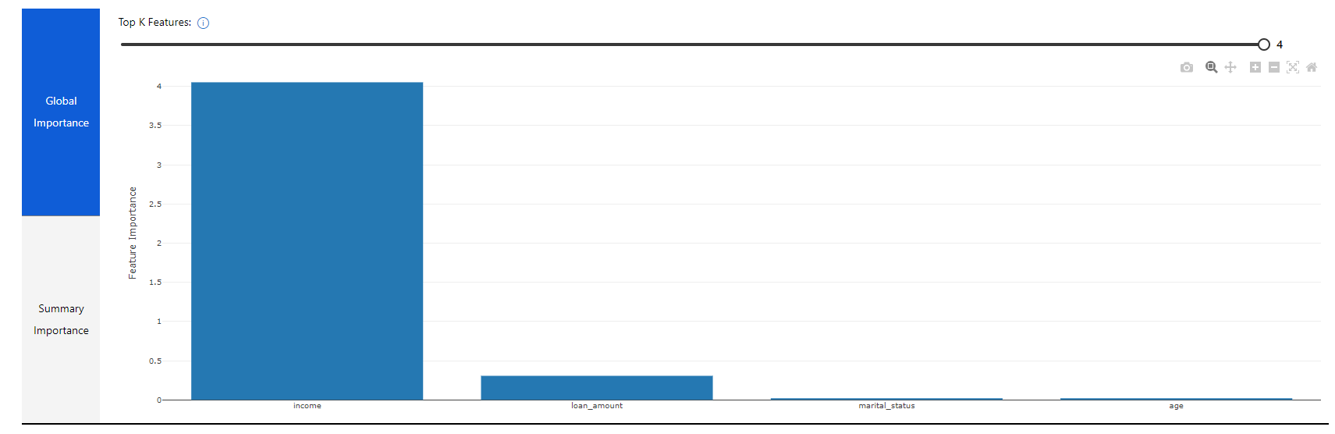
Visualizing Model Explanations
View the Explanations tab for the run in Azure Machine Learning studio

Slide 9
Lab 9A
Reviewing Automated Machine Learning Explanations
https://aka.ms/msl-dp100

Slide 10
Lesson Review
Complete the Review Questions

Slide 11
Lesson 2
Using Model Explainers
Data
Cloud
AI

Slide 12
Local Model Interpretation
Use the azureml-interpret package
Create an explainer:
MimicExplainer – global surrogate model that approximates your model
TabularExplainer – Invokes direct SHAP explainer based on model architecture
PFIExplainer – Permutation Feature Importance based on feature shuffling
Get global or local feature explanations
from interpret.ext.blackbox import TabularExplainer
tab_explainer = TabularExplainer(model, X_train, features=features, classes=labels)
global_explanation = tab_explainer.explain_global(X_train)

Slide 13
Adding Interpretability to Training Experiments
In the training script, import the ExplanationClient class
Generate explanations and upload them to the run
Use ExplanationClient to download explanations
explain_client = ExplanationClient.from_run(run)
explainer = MimicExplainer(model, X_train, LinearExplainableModel,
features=features, classes=labels)
explanation = explainer.explain_global(X_test)
explain_client.upload_model_explanation(explanation, comment='Model Explanation')
from azureml.contrib.interpret.explanation.explanation_client import ExplanationClient
client = ExplanationClient.from_run_id(workspace=ws,
experiment_name=experiment.experiment_name,
run_id=run.id)
explanation = client.download_model_explanation()

Slide 14
Interpretability During Inferencing 預測
Register a lightweight scoring explainer with the model
Use the model and the explainer in the service scoring script
Deploy a service with the model and explainer
scoring_explainer = KernelScoringExplainer(explainer)
save(scoring_explainer, directory='dir', exist_ok=True)
Model.register(ws, model_name='model', model_path='dir/model.pkl')
Model.register(ws, model_name='explainer', model_path='dir/scoring_explainer.pkl')
def run(raw_data):
data = json.loads(raw_data)['data']
predictions = model.predict(data)
local_importance_values = explainer.explain(data)
return {"predictions":predictions.tolist()), "importance":local_importance_values}
service = Model.deploy(ws, 'classify_svc', [model, explainer], inf_config, dep_config)

Slide 15
Lab 9B
Interpreting Models
https://aka.ms/msl-dp100

Slide 16
Lesson Review
Complete the Review Questions

